Slide 1

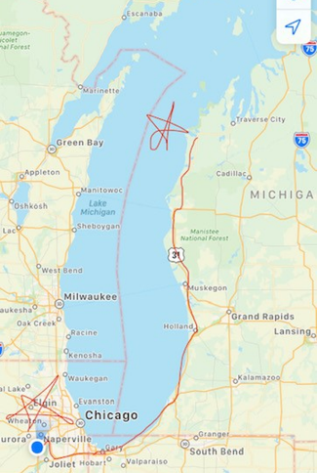
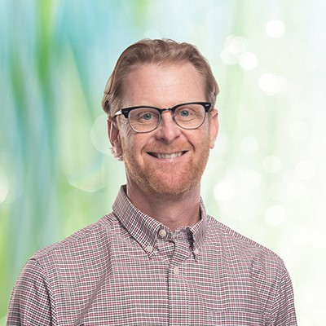
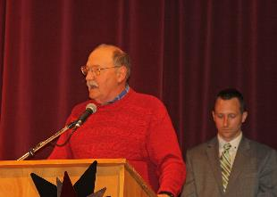
Keith Krause

Slide 2
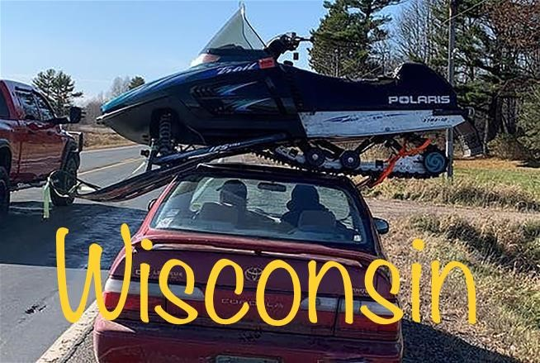
Why do I like Michigan?

Slide 3

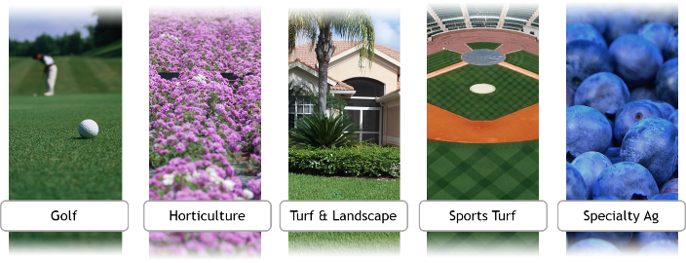

Slide 4

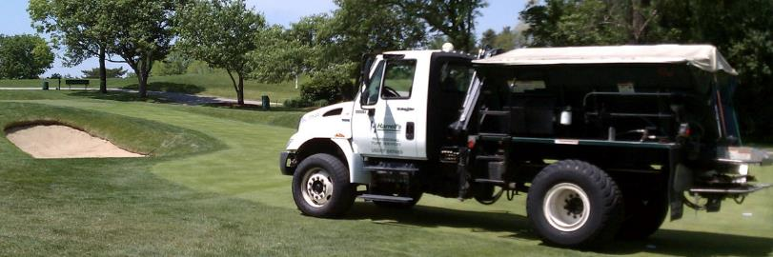

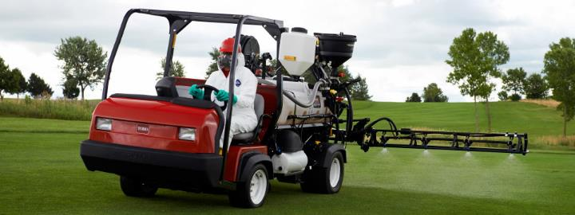

Slide 5
…Since 2014
Founded in 1942 in Lakeland Florida
Grown into a National company with 300+ employees
100% employee-owned(2016)
Bought Patent to Polyon Fertilizer Technology
Both manufacture and distribute fertilizers and pesticides to the green industry

Slide 6
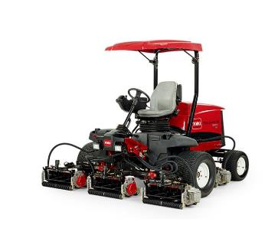
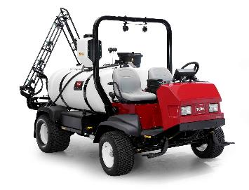
Fun golf industry facts!
749 golf courses in Michigan. 15,372 in the US.
Golf is tracking for 50 million more rounds over last year. Over 10% growth! 30% in October alone!
Record $1billion in golf equipment sales in 3rd quarter of 2020
Toro Fairway mower costs $75,000.00. Sprayer with GPS is $100k.

Slide 7


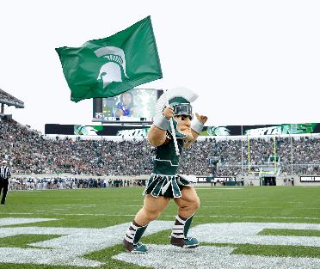
Follow your heart

Slide 8
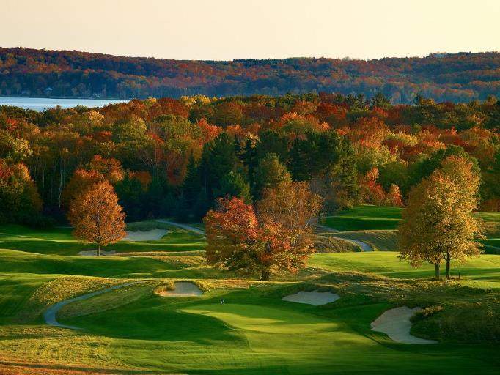

Crystal Downs yay!!

Slide 9
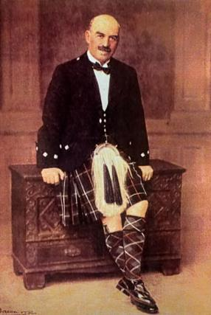
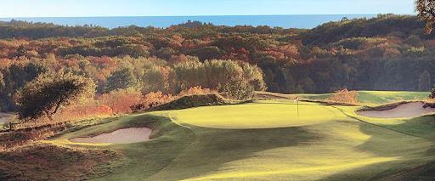
Dr. Alister Mackenzie

Slide 10
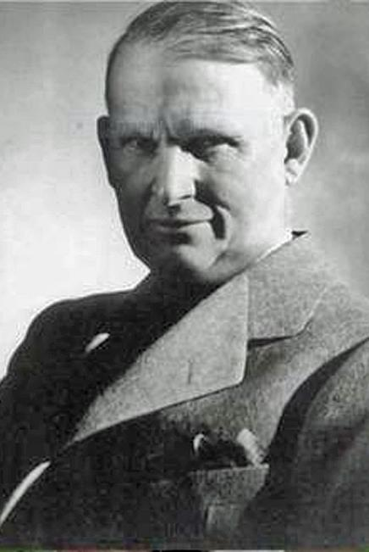
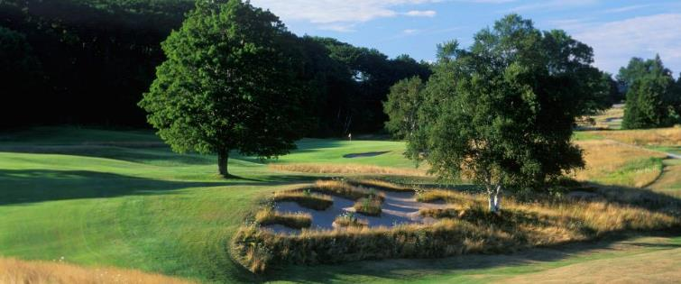
Perry Maxwell

Slide 11
The preservation for the next generation
Fred Muller (Past Golf Pro), Matt Smith(Golf Pro)
Mike Morris (Director Grounds/ Superintendent)
Don Roth (Superintendent), Dan Stratton (Mechanic), Drew Dougherty (assistant Superintendent)
The entire Crystal Downs Staff
David Rosenberger (Club Historian)
Membership

Slide 12
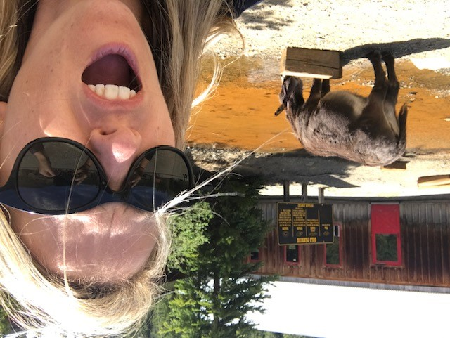











Slide 13
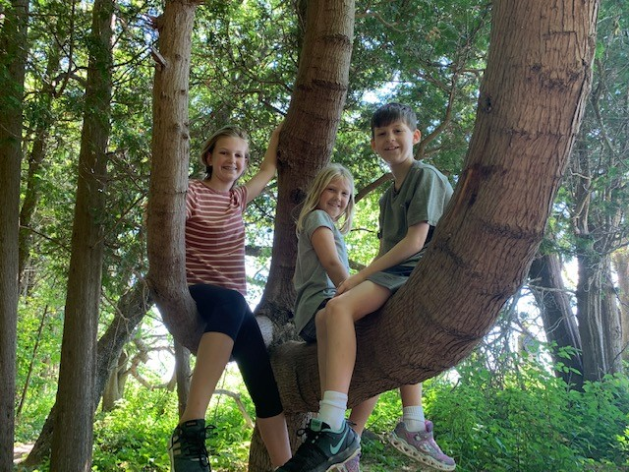

Slide 14
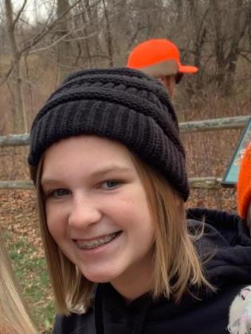
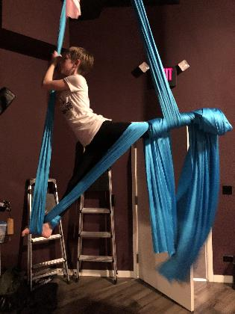
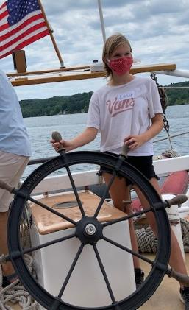
Lucy (14)

Slide 15
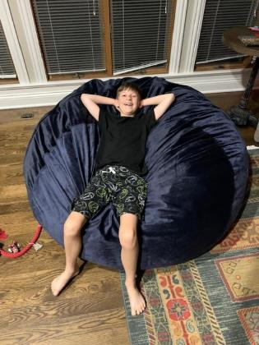
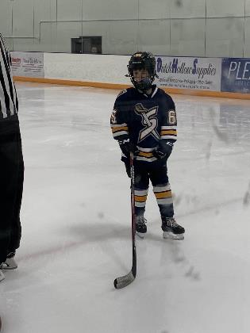
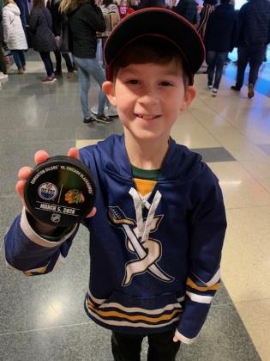
Max (11)

Slide 16
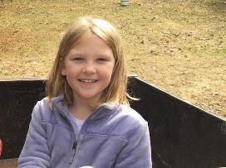
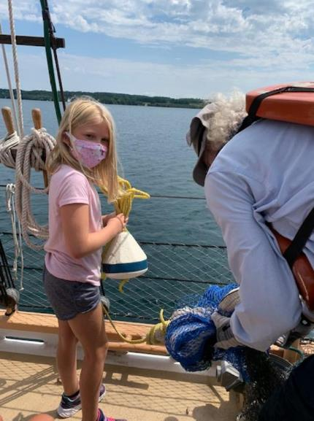
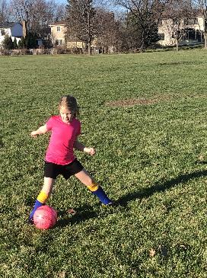
Delilah (9)

Slide 17
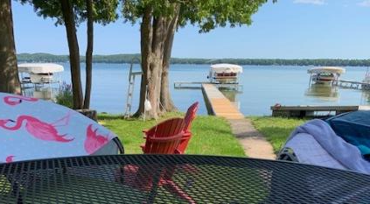
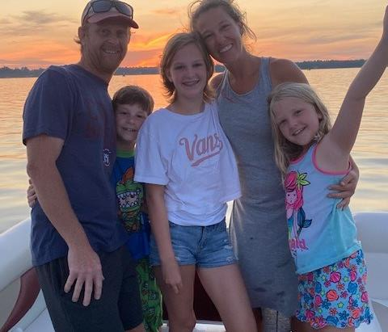
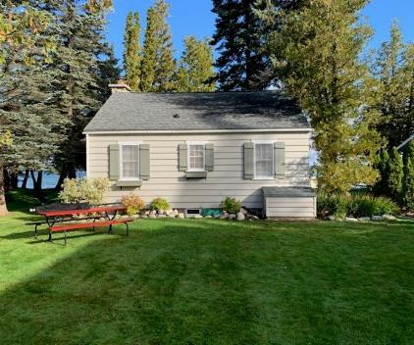

Slide 18
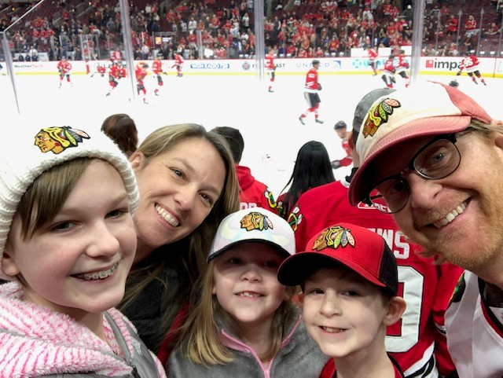

Slide 19
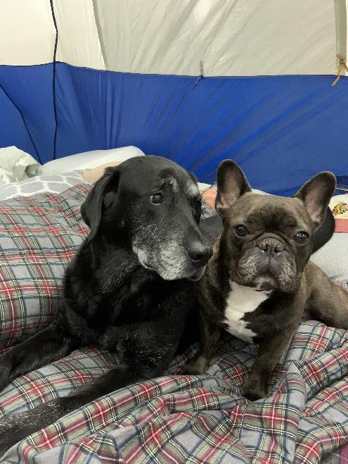
Hunter
Burt

Slide 20
Things you must know or else
Music
Hockey
Fishing
Snowmobiling
Golf/Golf Course Architecture
Comedy
Live Theater
Starbucks Egg Nog Lattes
Burritos

Slide 21
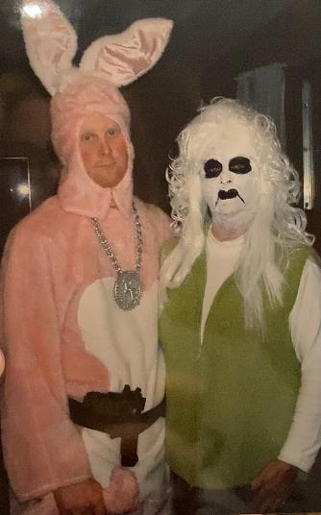
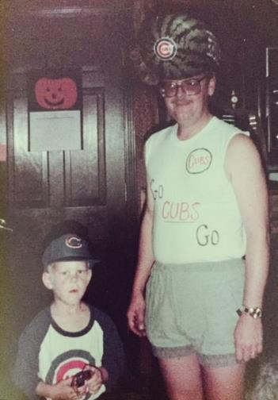
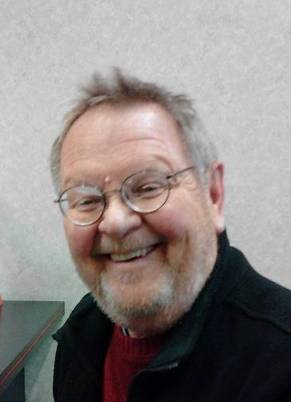
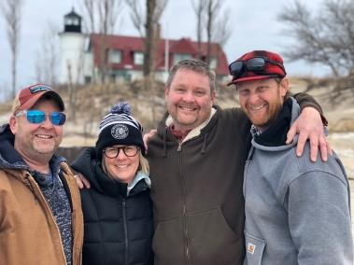
….. And why I’m here

Slide 22
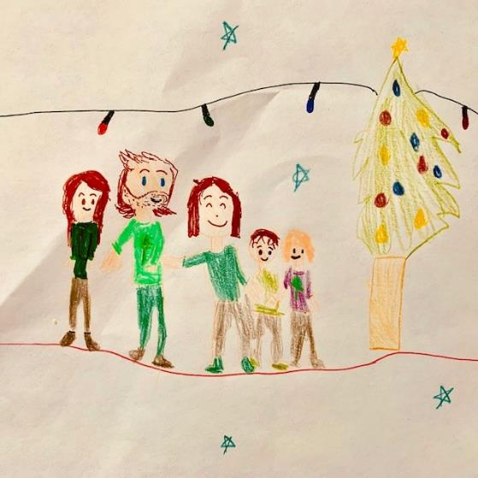
Merry Christmas!

